Slide 1
Open EHR
OpenEHR is an open standard specification in health informatics
It describes the managment and storage, retrieval and exchange of health data in electronic health records
One lifetime record per patient

Slide 2
Open EHR
Information systems we develop are domain specific
A large amount of information is required from the domain experts
Multi-level modeling includes the experts directly into development
This decreases errors and speeds up development

Slide 3
Electronic Health Records (EHR) are modeled in two levels.
First level represents the reference model
Second level are the archetypes and models
OpenEHR is generic and can be used in any domain

Slide 4
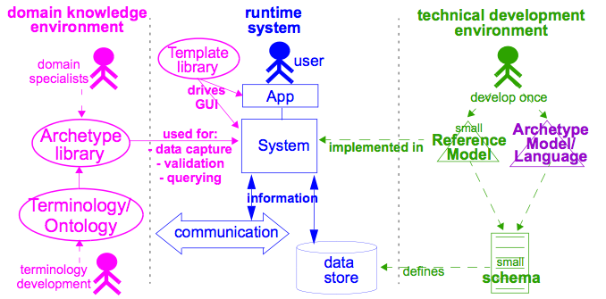
Two layer modeling in openEHR

Slide 5
How it works
Archetypes are created from reference models
They represent one concep (eg. Blood pressure)
Templates combine archetypes and allow for data to be collected (eg. Health examination)
When archetypes are exchanged between institutions it is important for the concepts to be correctly interpreted

Slide 6
Before the data is saved it must be validated
If successful the data is saved
Data is accesed using a special sintax of path and predicates

Slide 7
Reference model
The first level of openEHR is made with a reference model
This model is health-domain specific, but still very generic
It is built from a number of classes, which don't change, and represent the main building blocks of Electronic Health Records

Slide 8
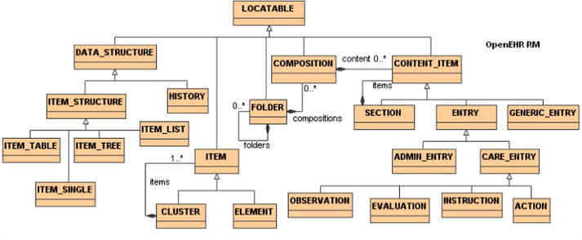
Reference model structure

Slide 9
Archetypes
Archetypes represent clinical concepts
They are structured and rule-bound combinations of entities from the reference model
Made for multiple use
Created using the ADL language
ADL is a formal language, using abstract sintax, used for representation of archetypes in text form

Slide 10
Templates
Template is a concept in openEHR, which defines one or more archetypes
Using templates we can combine archetypes and create new ones
Templates allow for renaming or ommiting certain nodes within archetypes which it is created from
The new archetype corresponds to a certain clinical event

Slide 11
Validation
When entering clinical information, the data must be validated before it is saved
Validation prevents entering wrong data
With out it the records could contain wrong or inaccurate data
Validation makes sure that data is within the limits defined in the archetype

